Slide 1
PROJECT TITLE
CAPSTONE PROJECT
Presented By:
Shirin Rifa A [421221214045] – Karpaga Vinayaga College of Engineering and Technology- B.Tech [Biotechnology]

Slide 2
OUTLINE
Problem Statement
Proposed System/Solution
System Development Approach
Algorithm & Deployment
Result
Conclusion
Future Scope
References

Slide 3
Problem Statement
Have you ever wondered when the best time of year to book a hotel room is? Or the optimal length of stay in order to get the best daily rate? What if you wanted to predict whether or not a hotel was likely to receive a disproportionately high number of special requests? This hotel booking dataset can help you explore those questions! This data set contains booking information for a city hotel and a resort hotel, and includes information such as when the booking was made, length of stay, the number of adults, children, and/or babies, and the number of available parking spaces, among other things. All personally identifying information has been removed from the data. Explore and analyse the data to discover important factors that govern the bookings.

Slide 4
Proposed Solution
import pandas as pd
import matplotlib.pyplot as plt
import seaborn as sns
# Step 1: Read Data from Excel File
df = pd.read_excel('hotel_booking_data.xlsx')
# Analyze booking trends over months
plt.figure(figsize=(10, 6))
sns.countplot(x='arrival_date_month', data=df, order=['January', 'February', 'March', 'April', 'May', 'June', 'July', 'August', 'September', 'October', 'November', 'December'])
plt.title('Monthly Booking Trends')
plt.xlabel('Month')
plt.ylabel('Number of Bookings')
plt.xticks(rotation=45)
plt.tight_layout()
plt.show()gt33w3w

Slide 5
PROPOSED SOLUTION
# Analyze average daily rate (ADR) over months
plt.figure(figsize=(10, 6))
sns.barplot(x='arrival_date_month', y='adr', data=df, order=['January', 'February', 'March', 'April', 'May', 'June', 'July', 'August', 'September', 'October', 'November', 'December'])
plt.title('Average Daily Rate (ADR) by Month')
plt.xlabel('Month')
plt.ylabel('ADR')
plt.xticks(rotation=45)
plt.tight_layout()
plt.show()
# Analyze distribution of booking lengths
plt.figure(figsize=(10, 6))
sns.histplot(df['stays_in_weekend_nights'] + df['stays_in_week_nights'], bins=30, kde=False)
plt.title('Distribution of Booking Lengths')
plt.xlabel('Length of Stay (Nights)')
plt.ylabel('Frequency')
plt.tight_layout()
plt.show()

Slide 6
PROPOSED SOLUTION
# Analyze relationship between length of stay and ADR
plt.figure(figsize=(10, 6))
sns.scatterplot(x='stays_in_weekend_nights' + df['stays_in_week_nights'], y='adr', data=df)
plt.title('Relationship between Length of Stay and ADR')
plt.xlabel('Length of Stay (Nights)')
plt.ylabel('ADR')
plt.tight_layout()
plt.show()
# Analyze correlation between special requests and other features
correlation_matrix = df.corr()
plt.figure(figsize=(12, 8))
sns.heatmap(correlation_matrix, annot=True, cmap='coolwarm')
plt.title('Correlation Matrix')
plt.tight_layout()
plt.show()

Slide 7
System Approach
Python
Matplotlib
Pandas
Seaborn

Slide 8
Algorithm & Deployment
Step 1: Data Preprocessing
Load the dataset
Handle missing values and outliers
Step 2: Exploratory Data Analysis (EDA)
Visualize distributions of key variables
Analyze booking patterns over time
Investigate correlations between variables
Step 3: Feature Engineering
Create new features if necessary
Encode categorical variables

Slide 9
Algorithm & Deployment
Step 4: Analysis and Modeling
Analyze best time of year to book a hotel room
Analyze optimal length of stay
Predict disproportionately high number of special requests
Step 5: Evaluation and Interpretation
Evaluate model performance
Interpret findings and provide insights

Slide 10
Algorithm & Deployment
Data Preparation and Preprocessing
Feature Engineering
Exploratory Data Analysis (EDA)
Model Development
Model Evaluation
Deployment
Choose Deployment Platform
Implement Models
Develop User Interface
Testing
Monitoring and Maintenance

Slide 11
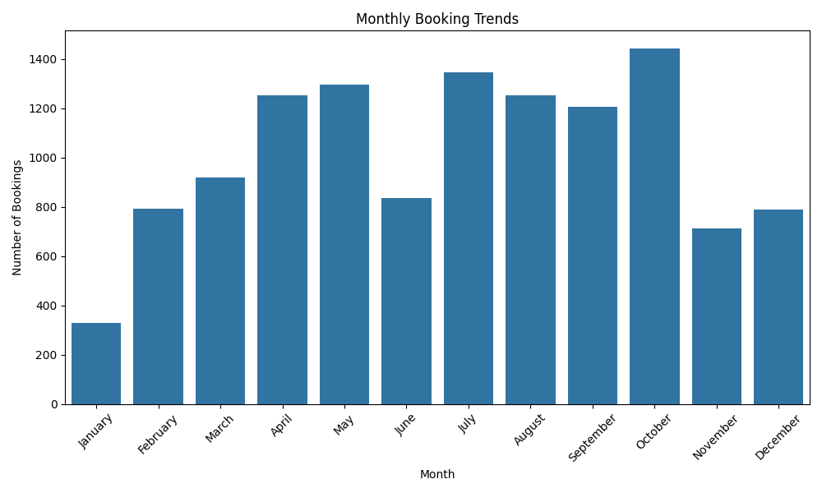
Result

Slide 12
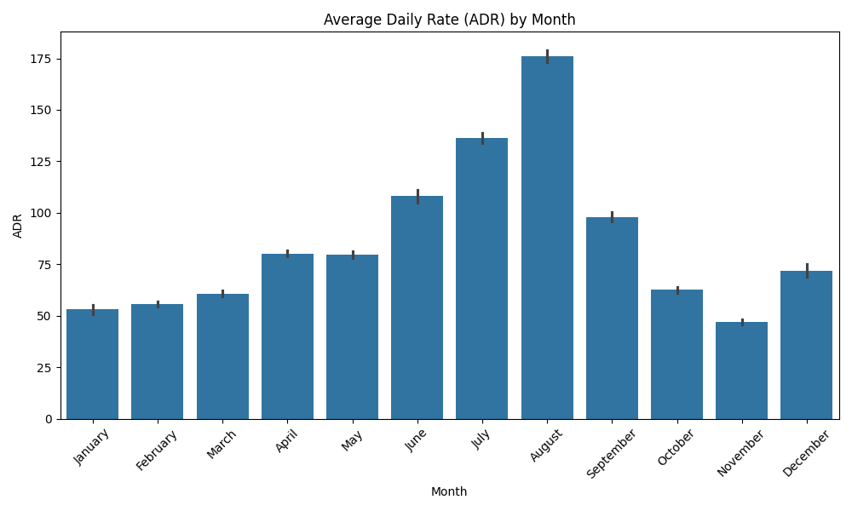
Result

Slide 13
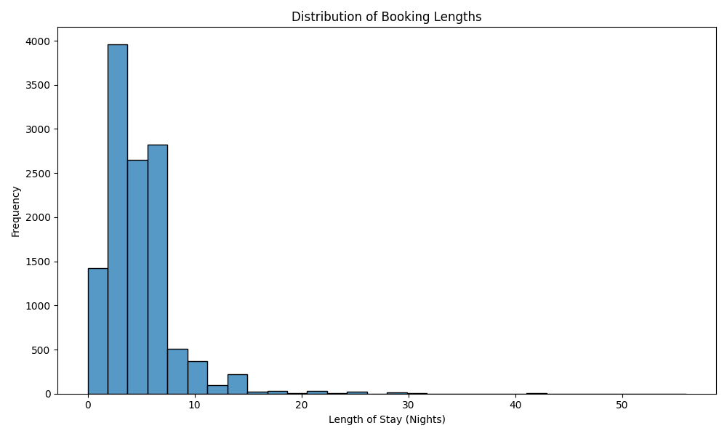
Result

Slide 14
Conclusion
The analysis of the hotel booking dataset has provided valuable insights into various aspects of hotel bookings.
Through exploration and analysis, we have determined the optimal time of year to book a hotel room, identified the factors influencing the best daily rate based on the length of stay, and developed predictive models to forecast the likelihood of a hotel receiving special requests.
By examining factors such as booking patterns, length of stay, and guest demographics, we have uncovered important trends that govern booking decisions.
These insights can empower hotel management to make informed decisions regarding pricing strategies, marketing campaigns, and service offerings, ultimately enhancing customer satisfaction and maximizing revenue.
Additionally, this analysis underscores the importance of data-driven approaches in the hospitality industry and highlights the potential of leveraging data to optimize hotel operations and improve overall performance.

Slide 15
Future scope
Enhanced Predictive Modeling
Dynamic Pricing Strategies
Personalized Recommendations
Demand Forecasting
Customer Segmentation
Operational Efficiency
Integration with External Data Sources

Slide 16
References
https://youtu.be/GsfT2sv_zCo?si=FHM-GMeTSb01x3sk

Slide 17
THANK YOU

